Slide 1
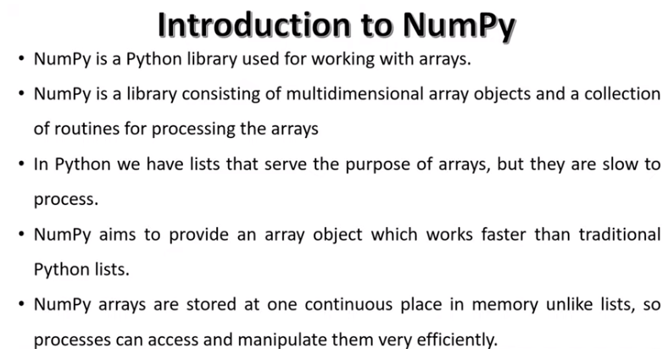

Slide 2
Introduction
NumPy, short for Numerical Python, is the fundamental package required for high performance scientific computing and data analysis.It Provides,
ndarray, a fast and space-efficient multidimensional array providing vectorized
arithmetic operations and sophisticated broadcasting capabilities
Standard mathematical functions for fast operations on entire arrays of data without having to write loops
Tools for reading / writing array data to disk and working with memory-mapped files
Linear algebra, random number generation, and Fourier transform capabilities
Tools for integrating code written in C, C++, and Fortran

Slide 3
Numpy Applications
An alternative for lists and arrays in Python-
Arrays in Numpy are equivalent to lists in python.
Like lists in python, the Numpy arrays are homogenous sets of elements.
It maintains uniformity for mathematical operations that would not be possible with heterogeneous elements.
Another benefit of using NumPy arrays is there are a large number of functions that are applicable.
NumPy maintains minimal memory
Arrays in NumPy are objects.
Python deletes and creates these objects continually, as per the requirements.
Hence, the memory allocation is less as compared to Python lists.
NumPy has features to avoid memory wastage in the data buffer.

Slide 4
Contd..
Using NumPy for multi-dimensional arrays.
We can also create multi-dimensional arrays in NumPy.
These arrays have multiple rows and columns.
These arrays have more than one column that makes these multi-dimensional.
Multi-dimensional array implements the creation of matrices.easy to implement. And work it.
Mathematical operations with NumPy.
Working with NumPy also includes easy to use functions for mathematical computations on the array data set.
There are functions for Linear Algebra, bitwise operations, Fourier transform, arithmetic operations, string operations, etc.

Slide 5
Numpy Array Applications
Shape Manipulations
Array Generation
Array Dimensions
Numpy Applications with Other Libraries
NumPy with Pandas
NumPy with Matplotlib
NumPy with SciPy
NumPy with Tkinter

Slide 6
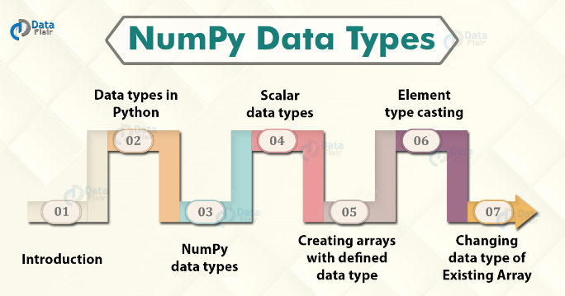
NumPy Data Types – Object and Parameters
The options for data type specification widens for the array elements.

Slide 7
Data Types in Python
1. strings- used to represent text data, the data is given in quotes. E.g.”abcd” 2. integer- used for representing numbers. E.g. 1,3 3. float- used for real number representations. E.g. 1.2,5.6 4. boolean- used for true or false type output 5. complex- used for the complex plain representation of numbers. E.g. 1.0+2.0j, 1.5+2.5j

Slide 8
NumPy Built-in Data Types
We can reference the built-in data types in NumPy by particular character code.
i – integer
b – boolean
u – unsigned
f – float
c – complex float
m – timedelta
M – datetime
O – object
S – string
U – unicode string
V – void

Slide 9
Numpy Scalar Data Types
The following scalar data types are available in NumPy:
1. bool_ – It is used to return Boolean true or false values. 2. int_ – It is the default integer type (int64 or int32) 3. intc – It is identical to the integer in C (int32 or int64) 4. intp – It is the integer value used for indexing 5. int8 – It is for assigning 8-bit integer value (-128 to 127) 6. int16 – It is for assigning 16-bit integer value (-32768 to 32767) 7. int32 – It is for assigning 32-bit integer value (-2147483648 to 2147483647) 8. int32 – It is for assigning 64-bit integer value (-9223372036854775808 to 9223372036854775807) 9. uint8 – It is for assigning unsigned 8-bit integer value (0 to 255) 10. uint16 – It is for assigning unsigned 16-bit integer value (0 to 65535) 11. uint32 – It is for assigning unsigned 32-bit integer value (0 to 4294967295) 12. uint64 – It is for assigning unsigned 64-bit integer value (0 to 18446744073709551615) 13. float_ – It is to assign float values. 14. float16 – It is for half precision float values. 15. float32 – It is for single-precision float values. 16. float64 – It is for double-precision float values. 17. complex_ – It is to assign complex values. 18. complex64 – It is to represent two 32-bit float complex values (real and imaginary) 19. complex128 – It is to represent two 64-bit float complex values (real and imaginary)

Slide 10
NumPy Dataype Object
The arrays in Numpy are homogenous in nature.
The elements of the array have the same data type.
The data type of the elements is given by the dtype object.
It is an object comprising of a combination of all the fundamental data types. It has the following syntax.
numpy.dtype(obj, align=False, copy=False)
Parameters
obj Data that has to be converted to a data-type object.
align bool, optional It is true if we have string or dictionary input.
copy bool, optional We set this is we want to make a new copy of the data-type object.

Slide 11
Ex:
np.dtype(np.int16) o/p:
Checking the Data Type of an array
The dtype property is useful to return the data type of the array object
arr = np.array([1, 2, 3, 4])
print(arr.dtype) o/p:
Creating Arrays with a Defined Data Type
We use the array()function to create arrays, the function can take dtype as an argument that helps define the define the data type of the array elements.
import numpy as np
arr = np.array([1, 2, 3, 4], dtype='i4')
print(arr)
print(arr.dtype) o/p:

Slide 12
Ex:
Element type casting
If we give a type to elements that cannot be cast then a value error will generate.
import numpy as np
arr = np.array(['a', '2', '3'], dtype='i') o/p:
Changing Data Type of Existing Array
This function creates a copy of the existing array. It then allows specifying the new data type for the copy as a parameter.
The data type can be specified using the respective character code.
arr = np.array([1.1, 2.1, 3.1])
newarr = arr.astype('i')
print(newarr)
print(newarr.dtype) o/p:

Slide 13
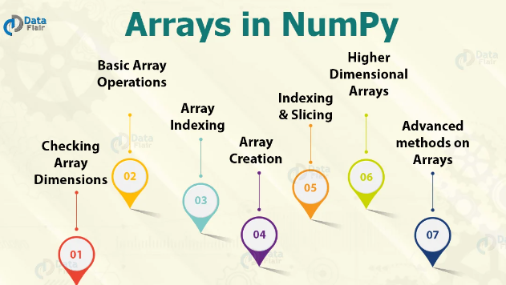
NumPy Array Operations and Methods The most important feature of NumPy is the homogeneous high-performance n-dimensional array object. Data manipulation in Python is nearly equivalent to the manipulation of NumPy arrays.

Slide 14
Numpy Array Basics
Arrays in NumPy are synonymous with lists in Python with a homogenous nature.
The homogeneity helps to perform smoother mathematical operations.
These arrays are mutable. NumPy is useful to perform basic operations like finding the dimensions, the bite-size, and also the data types of elements of the array.

Slide 15
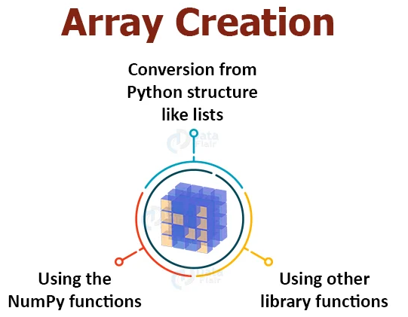
NumPy Array Creation

Slide 16
Using the NumPy functions
NumPy has a variety of built-in functions to create an array.
a. Creating one-dimensional array in NumPy
For 1-D arrays the most common function is np.arange(..), passing any value create an array from 0 to that number.
import numpy as np
array=np.arange(20)
array o/p:
We can check the dimensions by using array.shape.

Slide 17
Contd..
b. Creating two-dimensional arrays in NumPy
We can use reshape()function along with the arange() function to create a 2D array. The reshape()function specifies the rows and columns.
array=np.arange(20).reshape(4,5) o/p:
c. Using other NumPy functions
We can use other functions like and to quickly create filled arrays.
np.zeros((2,4))
np.ones((3,6)) o/p:
The .empty() function creates an array with random variables and the .full() function creates an n*n array with the given value.
np.empty((2,3))
np.full((2,2), 3) o/p:
The .eye( , )function creates an array with diagonals as 1 and othervalues as 0. The .linspace(, ,)function outputs an equally spaced array.
np.eye(3,3)
np.linspace(0, 10, num=4) o/p:

Slide 18
Using other library functions
We can use the function to create an array with random values between 0 and 1. This is a useful case in scenarios with random nature.
np.random.random((2,3)) o/p:
NumPy Array Indexing
Indexing of the array has to be proper in order to access and manipulate its values. Indexing can be done through:
Slicing – we perform slicing on NumPy arrays with the declaration of a slice for all the dimensions.
Integer array Indexing– users can pass lists for one to one mapping of corresponding elements for each dimension.
Boolean Array Indexing– we can pick elements after satisfying a particular Boolean condition.

Slide 19
NumPy Basic Array Operations
There is a vast range of built-in operations that we can perform on these arrays.
1. ndim – It returns the dimensions of the array. 2. itemsize – It calculates the byte size of each element. 3. dtype – It can determine the data type of the element. 4. reshape – It provides a new view. 5. slicing – It extracts a particular set of elements. 6. linspace – Returns evenly spaced elements. 7. max/min , sum, sqrt 8. ravel – It converts the array into a single line.
There are also a few Special Operations like sine, cosine, tan, log, etc.

Slide 20
Checking Array Dimensions in NumPy
We can determine the NumPy array dimensions using the ndim attribute. The argument return an integer that indicates the array dimension.
import numpy as np
a = np.array(10)
b = np.array([1,1,1,1])
c = np.array([[1, 1, 1], [2,2,2]])
d = np.array([[[1, 1, 1], [2, 2, 2]], [[3, 3, 3], [4, 4, 4]]])
print(a.ndim)
print(b.ndim)
print(c.ndim)
print(d.ndim) o/p:

Slide 21
Higher Dimensional Arrays in NumPy
In Numpy we can have arrays with any number of dimensions. There can be arrays with a high number of dimensions. We define the number of dimensions with the ndim argument.
import numpy as np
arr = np.array([1, 1, 1, 1, 1], ndmin=10)
print(arr)
print('number of dimensions :', arr.ndim) o/p:
Note:In the above example, the innermost dimension (10th dim) has 5 elements, the 9th dim has 1 element that is the vector, the 8th dim has 1 element that is the matrix with the vector, the 7th dim has 1 element that is 3D array 6th dim has 1 element that is a 4D array and so on

Slide 22


Slide 23
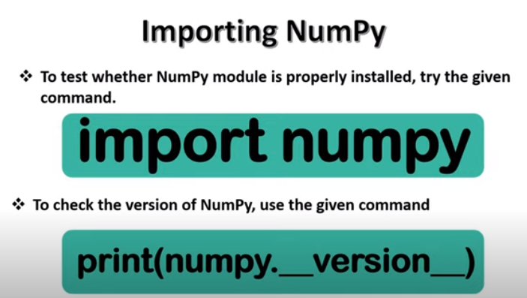

Slide 24
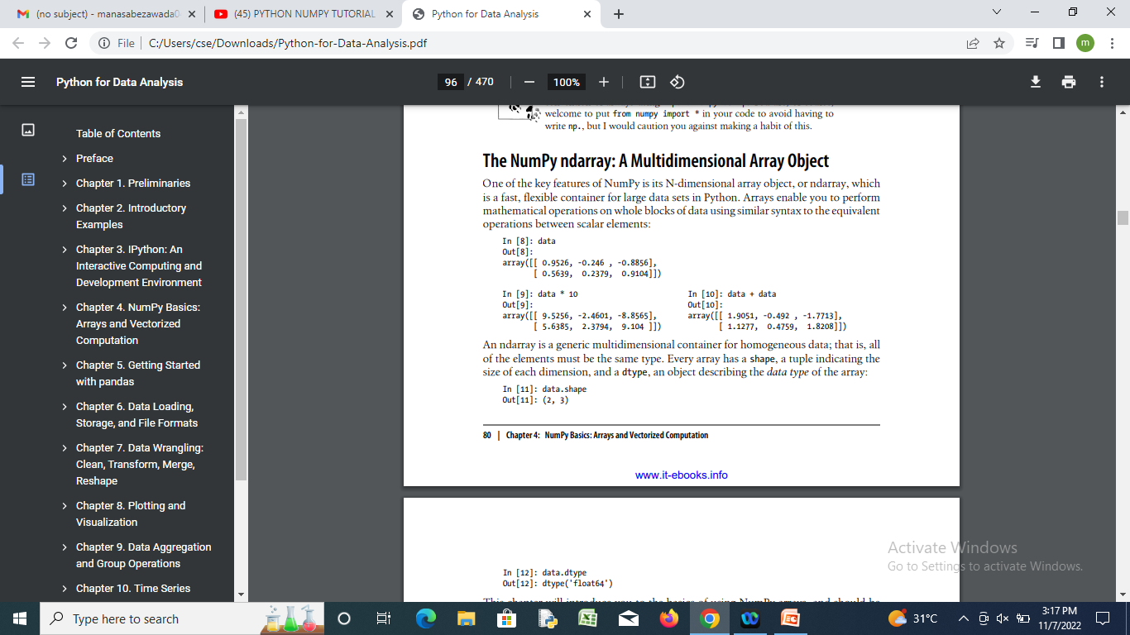
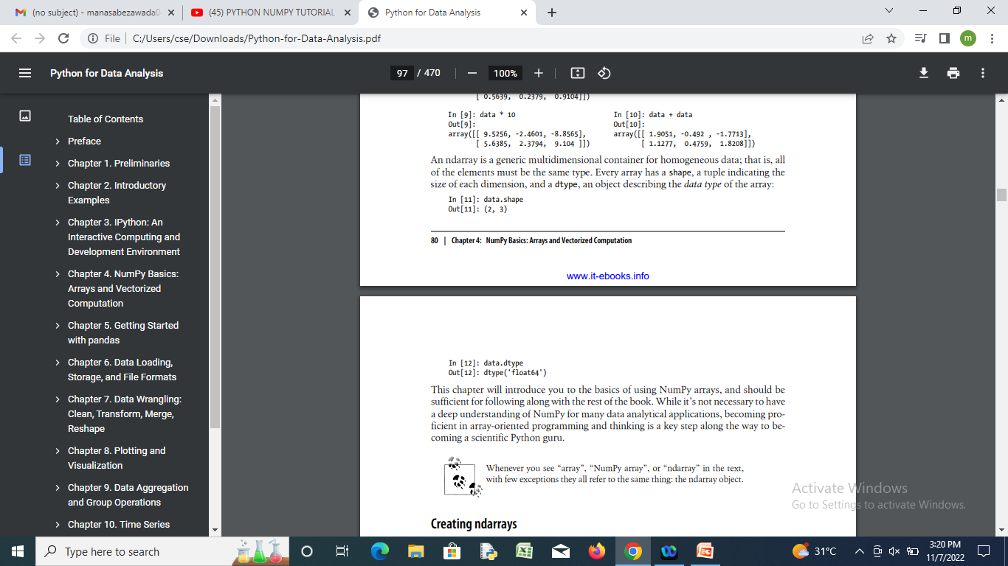
The NumPy ndarray: A Multidimensional Array Object
Every array has a shape, a tuple indicating the size of each dimension, and a dtype, an object describing the data type of the array

Slide 25
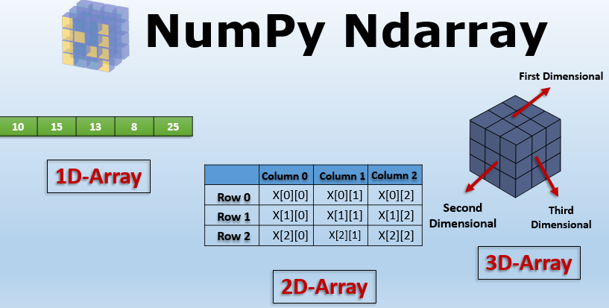

Slide 26
The N-dimensional array (ndarray)
An ndarray is a (usually fixed-size) multidimensional container of items of the same type and size.
The number of dimensions and items in an array is defined by its shape, which is a tuple of N non-negative integers that specify the sizes of each dimension.
The type of items in the array is specified by a separate data-type object (dtype), one of which is associated with each ndarray.

Slide 27
the contents of an ndarray can be accessed and modified by indexing or slicing the array (using, for example, N integers), and via the methods and attributes of the ndarray.
Different ndarrays can share the same data, so that changes made in one ndarray may be visible in another.
That is, an ndarray can be a “view” to another ndarray, and the data it is referring to is taken care of by the “base” ndarray.
ndarrays can also be views to memory owned by Python strings or objects implementing the buffer or array interfaces.

Slide 28
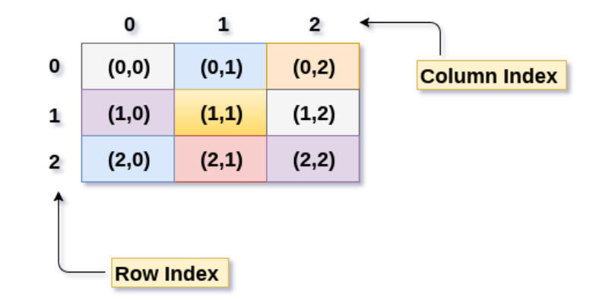
we have explored 2D array in Numpy in Python.

Slide 29
Numpy a library in Python adding support for large multidimensional arrays and matrices along with high level mathematical functions to operate these arrays.
Benefits of Numpy :
Numpy are very fast as compared to traditional lists because they use fixed datatype and contiguous memory allocation.
Numpy has lot more functions.

Slide 30
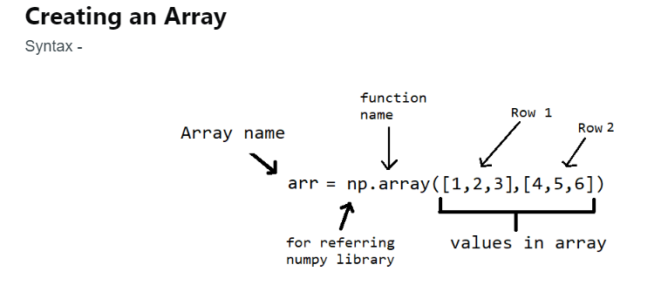
arr = np.array([2,4,6], dtype='int32') print(arr) o/p:

Slide 31
Accessing/Indexing specific element
To get a specific element from an array use arr[r,c]
arr[1,1] o/p:
arr[1,:] #This will return all elements of 1st row in the form of array
# Accessing multiple rows and columns at a time
arr = np.ones((4,4))
t = arr[1:3,1:3]
print(t)
# t will be a 2x2 matrix with 4 elements

Slide 32
Initializing different types of an array
There are various built-in functions used to initialize an array Zeros Array: zeros((r,c)) - It will return an array with all elements zeros with r number of rows and c number of columns.
arr_zeros = np.zeros((3,5)) print(arr_zeros)
Ones Array Similar to zeros we can also have all elements as one by using ones((r,c))
arr_ones = 2*np.ones((3,5)) print(arr_ones)
Random Array random.rand(r,c) - this function will generate an array with all random elements.
arr_rand = np.random.rand(3,4) print(arr_rand)

Slide 33
Identity identity(r) will return an identity matrix of r row and r columns.
arr_i = np.identity(3) print(arr_i)
Operations on 2D array
Arithmetic Operations Applying scalar operations to an array.
a = np.array([[1,2,3],[4,6,2],[0,7,1]])
#array with size 3x3
#Scalar operation - It will operate with scalar to each element of an array
print(a+2)
print(a-4)
print(a*3)
print(a/2)
print(a**2)

Slide 34
Matrix operation for 2D matrix
a = np.array([[1,2,3],[4,6,2],[0,7,1]])
#array with size 3x3
b = np.array([[3,6],[1,4],[7,2]])
#array with size 3x2
c = np.array([[1,0,3],[2,3,1],[0,0,1]])
add = a+c
mul = np.matmul(a,b) #Matrix multiplication of a and b
print(add)
print(mul)

Slide 35
Finding Minimum and Maximum from all elements
np.min(b)
np.max(b)
Finding determinant of a Matrix
np.linag.det(a)
Sum of elements along the column and row
#To add all elements of a column
np.sum(b,axis=0)
#To add all elements of a row
np.sum(b,axis=1)
Reorganizing Array
Changing shape of an array
before = np.array([[1,2,3,4],[5,6,7,8]]) #it's dimensions are 2x4
after = before.reshape(4,2) #it's dimensions are 4x2
print(after)

Slide 36
Horizontal Stacking - Concatinating 2 arrays in horizontal manner
a = np.identity(2)
b = np.array([[1,2],[2,1]])
np.hstack((a,b))
o/p:
array([[1., 0., 1., 2.], [0., 1., 2., 1.]])
Vertical Stacking - Concatinating 2 arrays in vertical manner
a = np.identity(2)
b = np.array([[1,2],[2,1]])
np.vstack((a,b))

Slide 37
Example1:A 2-dimensional array of size 2 x 3, composed of 4-byte integer elements:
x = np.array([[1, 2, 3], [4, 5, 6]], np.int32)
>>> type(x)
o/p:<class 'numpy.ndarray'>
>>> x.shape= (2, 3) o/p:
>>> x.dtype o/p:dtype('int32')
The array can be indexed using Python container-like syntax:
>>> # The element of x in the *second* row, *third* column, namely, 6.
>>> x[1, 2]
o/p:6

Slide 38
For example slicing can produce views of the array:
y = x[:,1]
>>> y
o/p:array([2, 5], dtype=int32)
y[0] = 9 # this also changes the corresponding element in x
>>> y
o/p:array([9, 5], dtype=int32)
>>>x
o/p:array([[1, 9, 3], [4, 5, 6]], dtype=int32)

Slide 39
Constructing arrays
New arrays can be constructed using the routines detailed in Array creation routines, and also by using the low-level ndarray constructor:
ndarray(shape[, dtype, buffer, offset, ...]) | An array object represents a multidimensional, homogeneous array of fixed-size items.

Slide 40
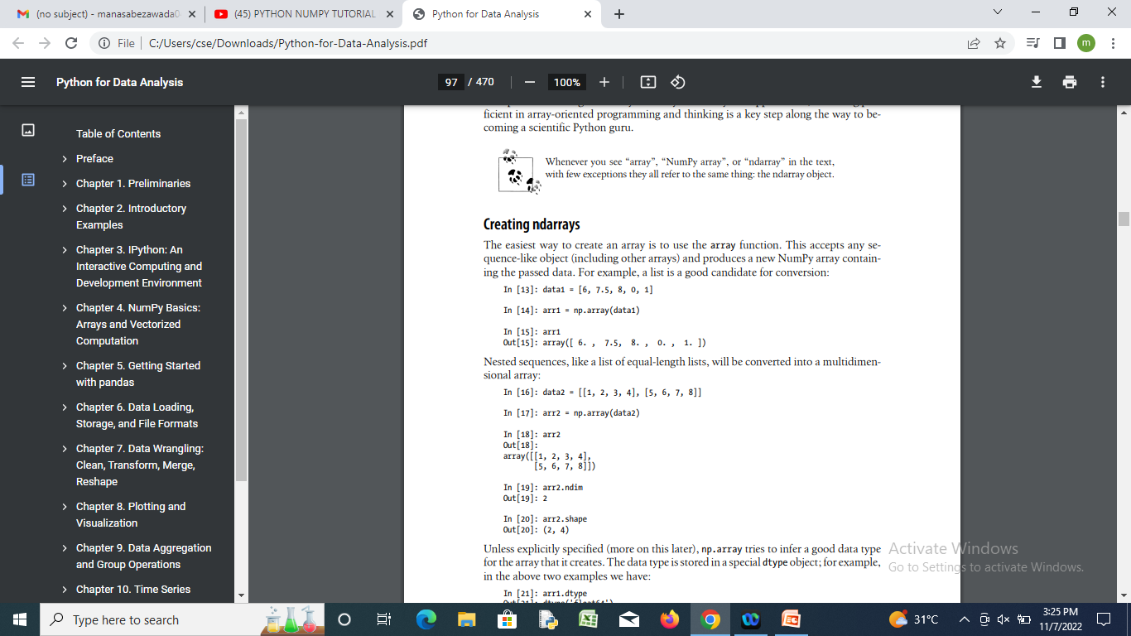

Creating ndarrays
A list of equal-length lists, will be converted into a multidimensional array:

Slide 41
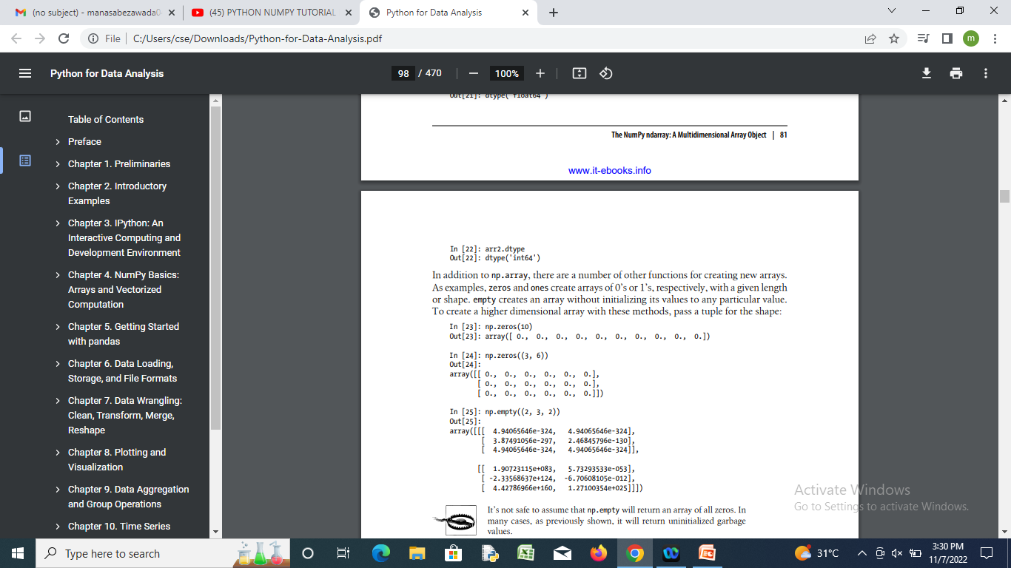
In addition to np.array, there are a number of other functions for creating new arrays.
As examples, zeros and ones create arrays of 0’s or 1’s, respectively, with a given length or shape.
empty creates an array without initializing its values to any particular value.

Slide 42
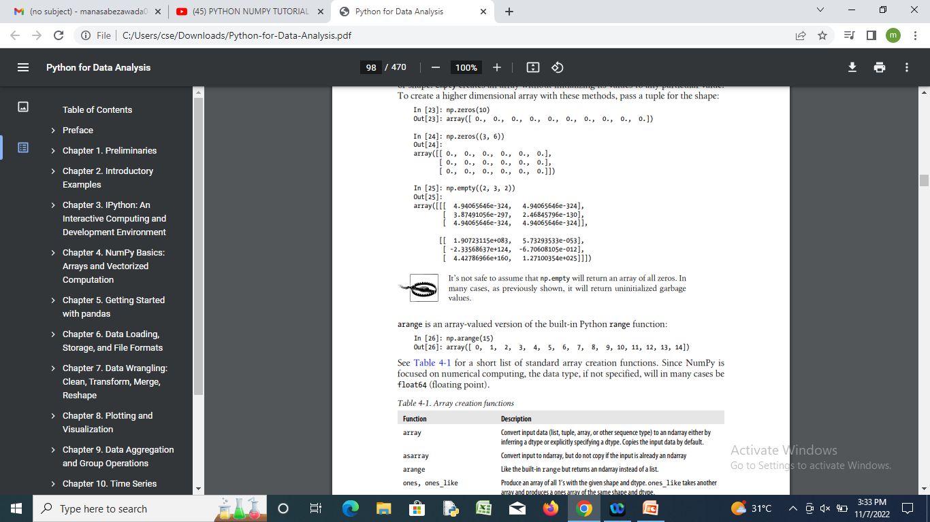
arange is an array-valued version of the built-in Python range function:

Slide 43
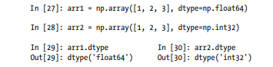
Data Types for ndarrays
The data type or dtype is a special object containing the information the ndarray needs to interpret a chunk of memory as a particular type of data:

Slide 44
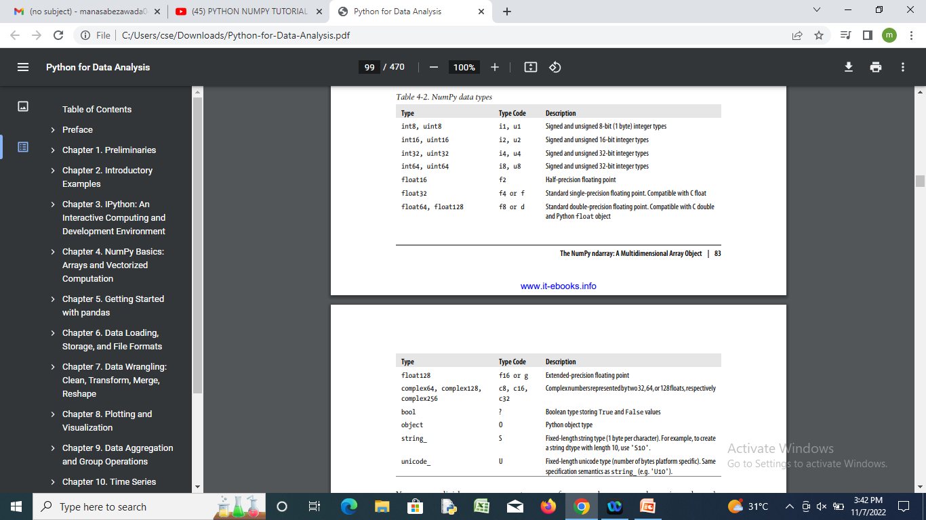

Slide 45
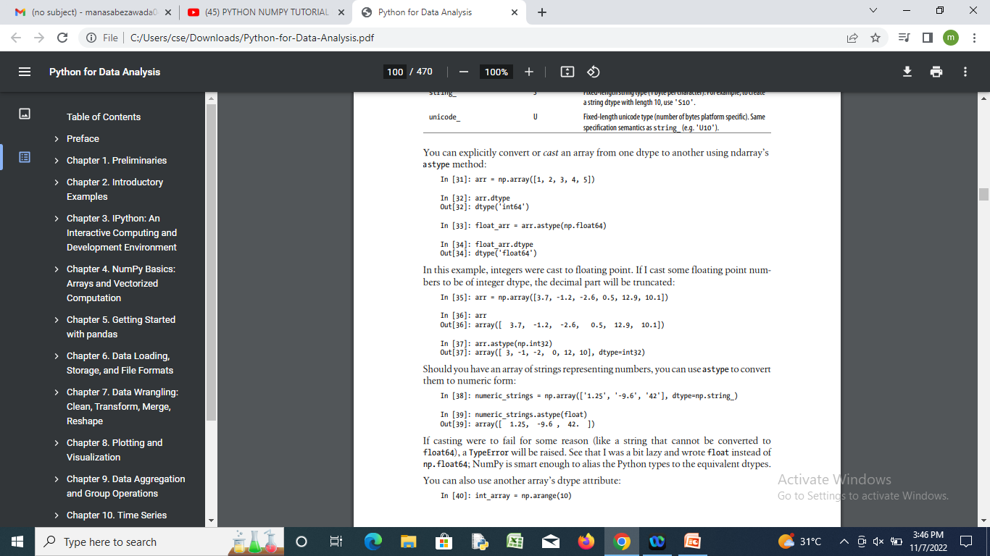
Can explicitly convert or cast an array from one dtype to another using ndarray’s astype method:
Cast some floating point numbers to be of integer dtype, the decimal part will be truncated:
An array of strings representing numbers, you can use astype to convert them to numeric form:

Slide 46
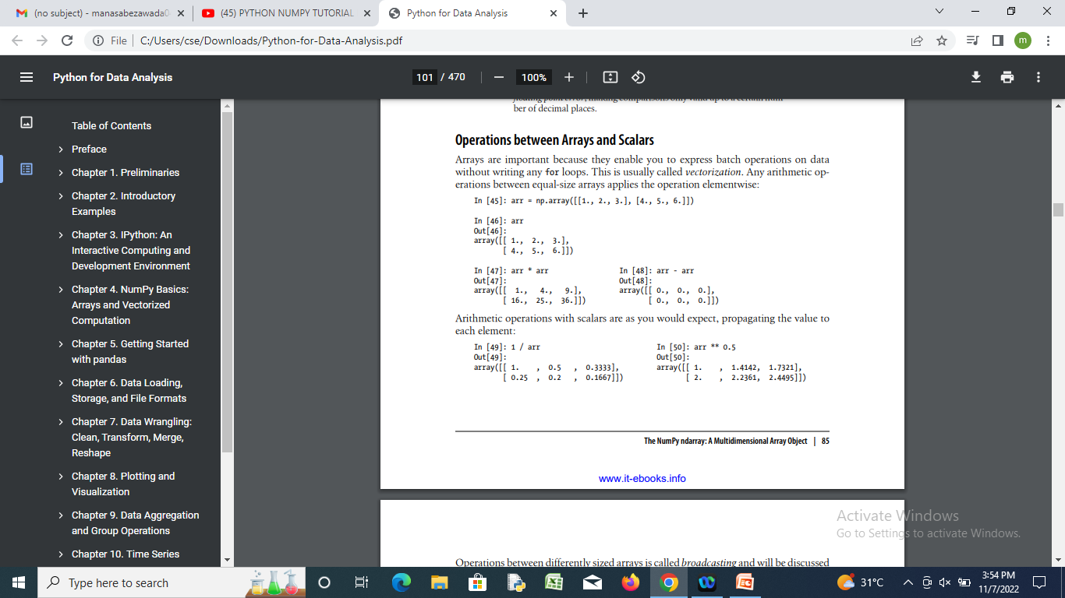
Operations between Arrays and Scalars

Slide 47
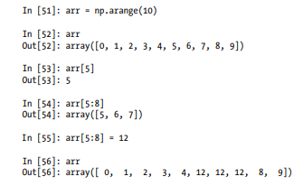
Basic Indexing and Slicing
There are many ways you may want to select a subset of your data or individual elements.
One-dimensional arrays are simple and act similarly to Python lists:

Slide 48
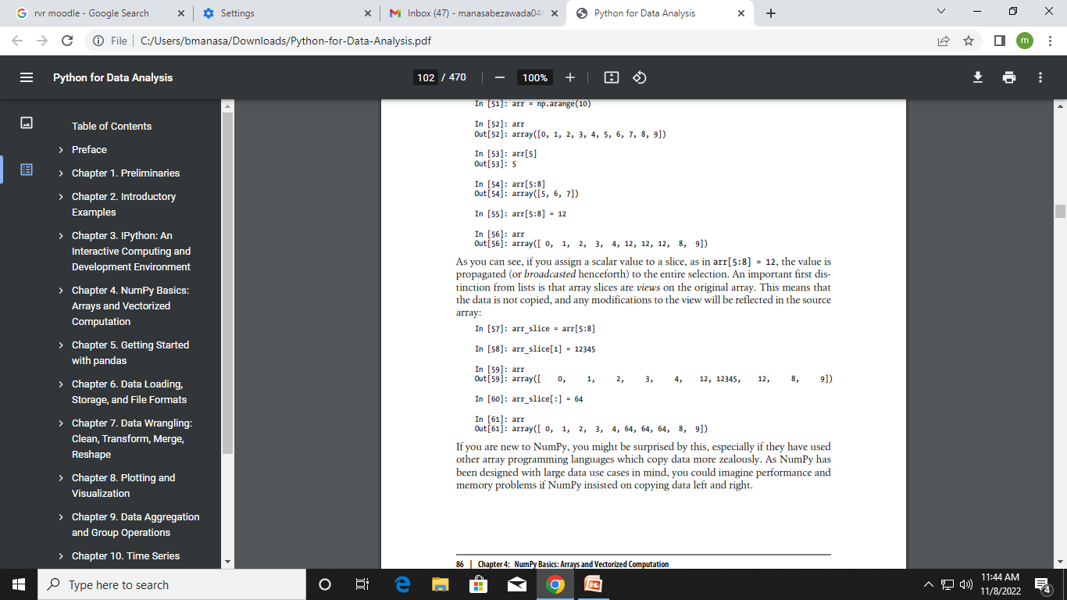
If we assign a scalar value to a slice, as in arr[5:8] = 12, the value is propagated (or broadcasted henceforth) to the entire selection.
An important first distinction from lists is that array slices are views on the original array. This means that the data is not copied, and any modifications to the view will be reflected in the source array:

Slide 49
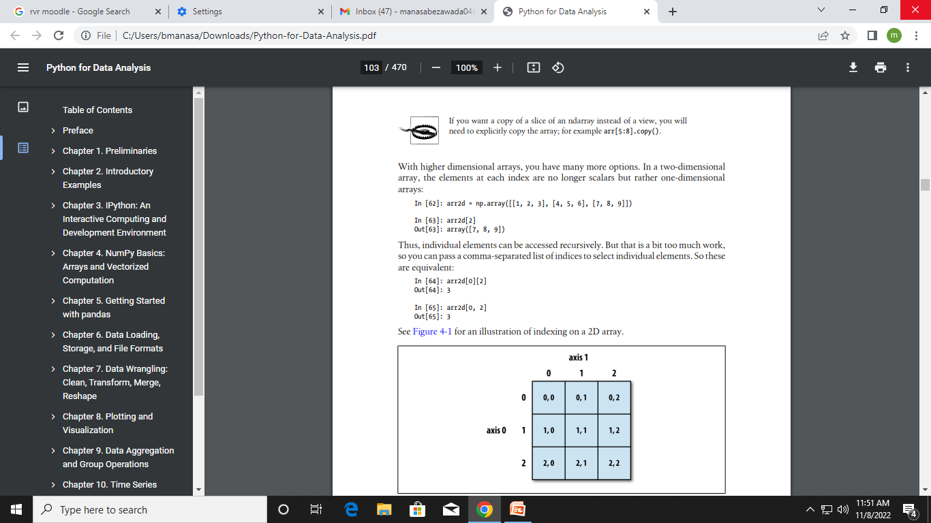
Two-dimensional array

Slide 50
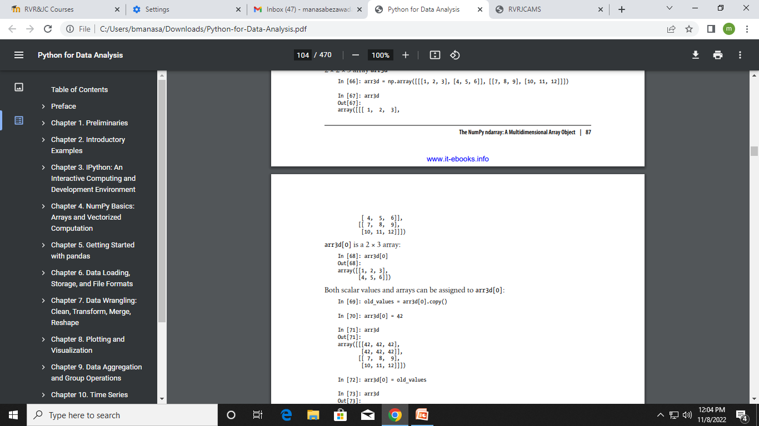
Multidimensional arrays

Slide 51
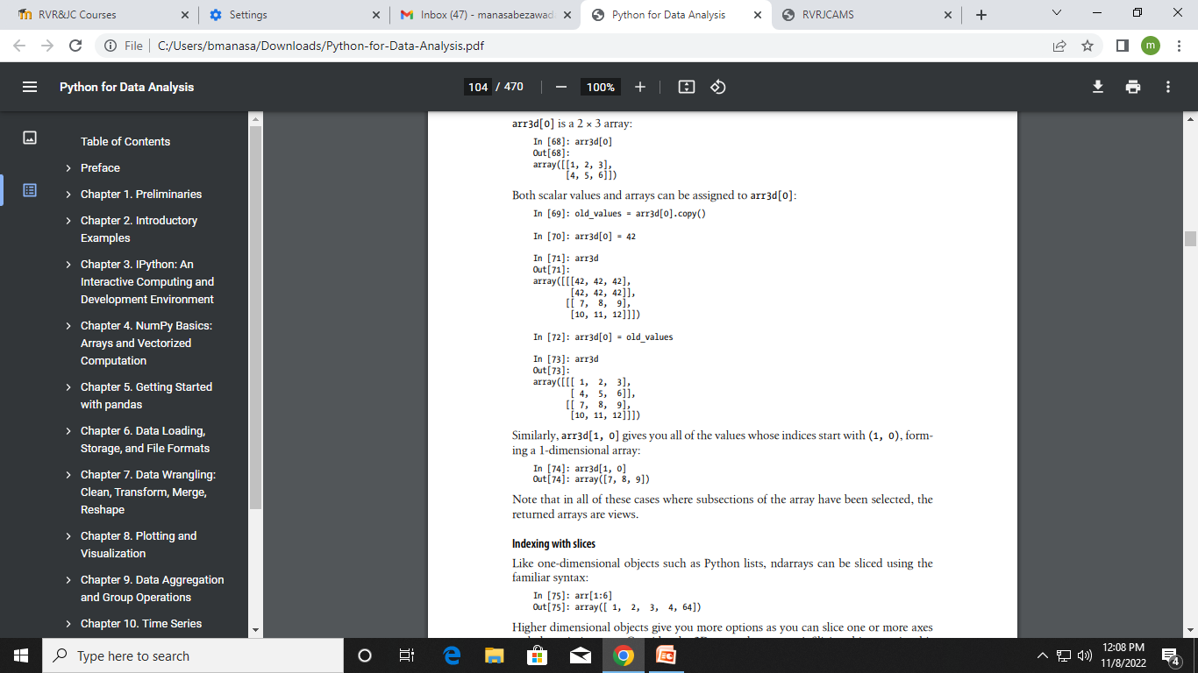

Slide 52
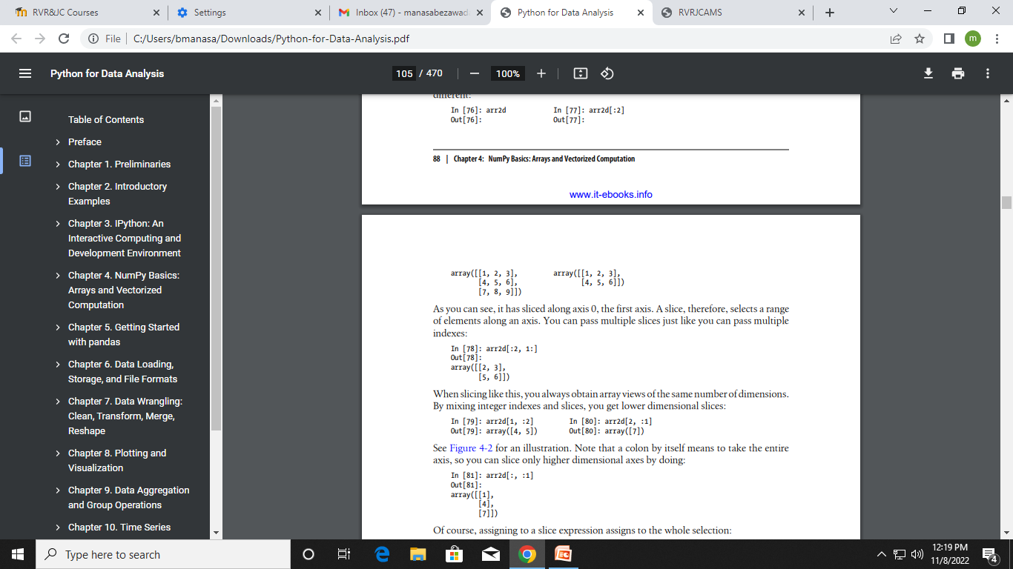
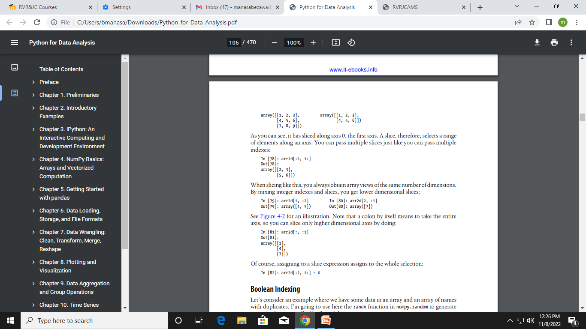
Higher dimensional objects give us more options as we can slice one or more axes and also mix integers.
Consider the 2D array , arr2d. Slicing this array is a bit different:
A slice, therefore, selects a range of elements along an axis. We can pass multiple slices just like you can pass multiple indexes:
A colon by itself means to take the entire axis, so we can slice only higher dimensional axes by doing:

Slide 53
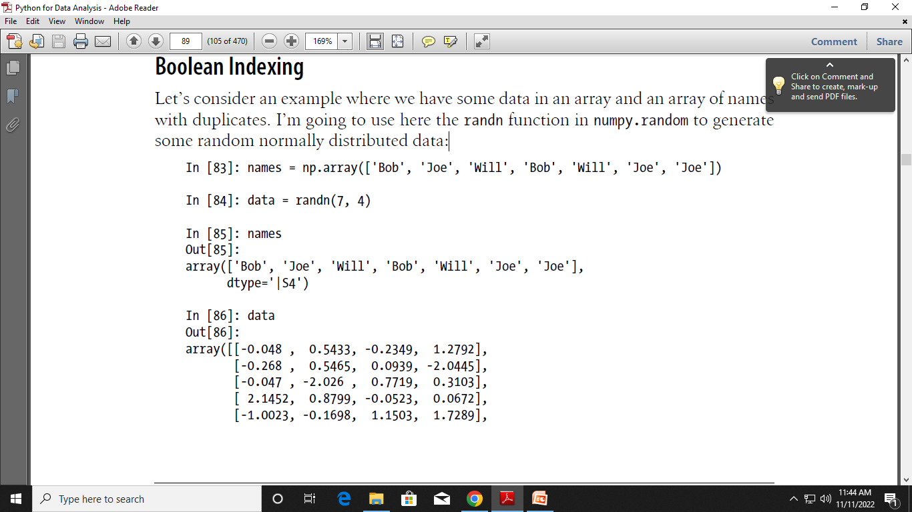
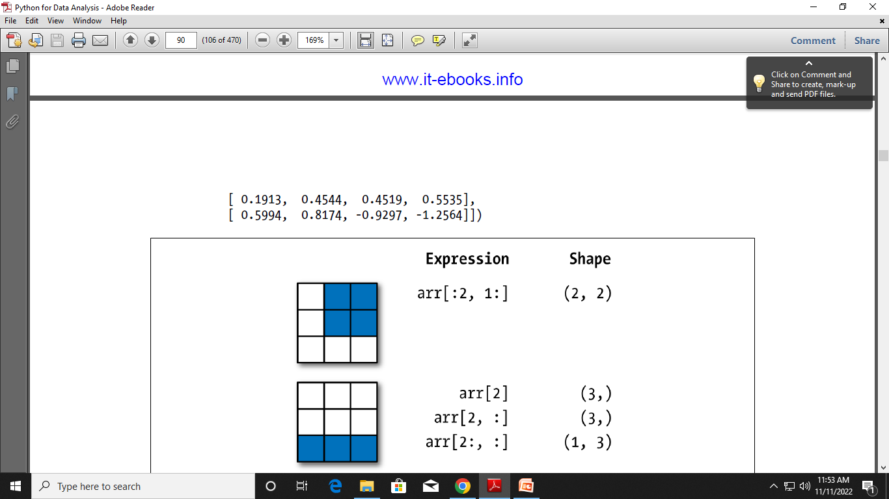
Boolean Indexing
Take one array of names with duplicates.
Take another array by using the randn function in numpy.random to generate some random normally distributed data:

Slide 54
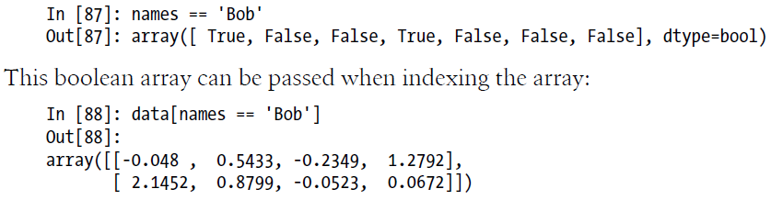
Each name corresponds to a row in the data array.
If we wanted to select all the rows with corresponding name 'Bob'.
Like arithmetic operations, comparisons (such as ==) with arrays are also vectorized. Thus, comparing names with the string 'Bob' yields a boolean array:

Slide 55
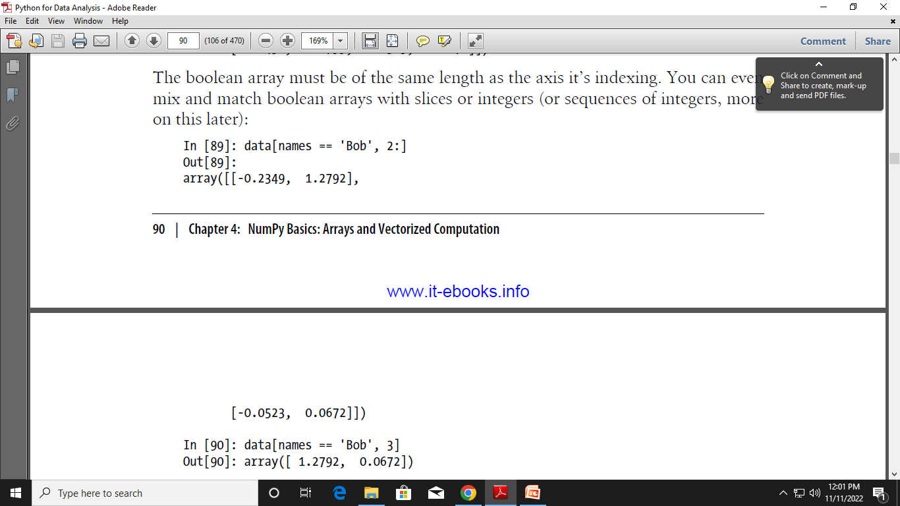
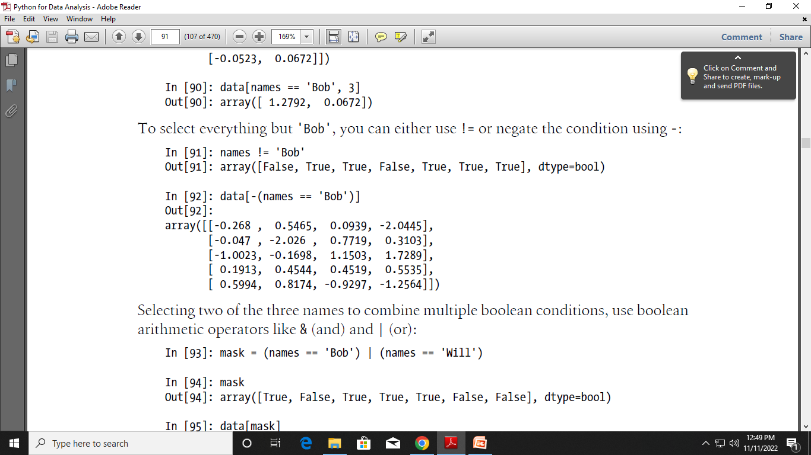
We can even mix and match boolean arrays with slices or integers

Slide 56
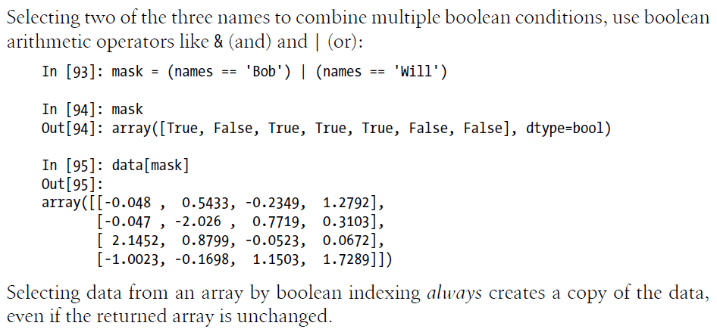

Slide 57
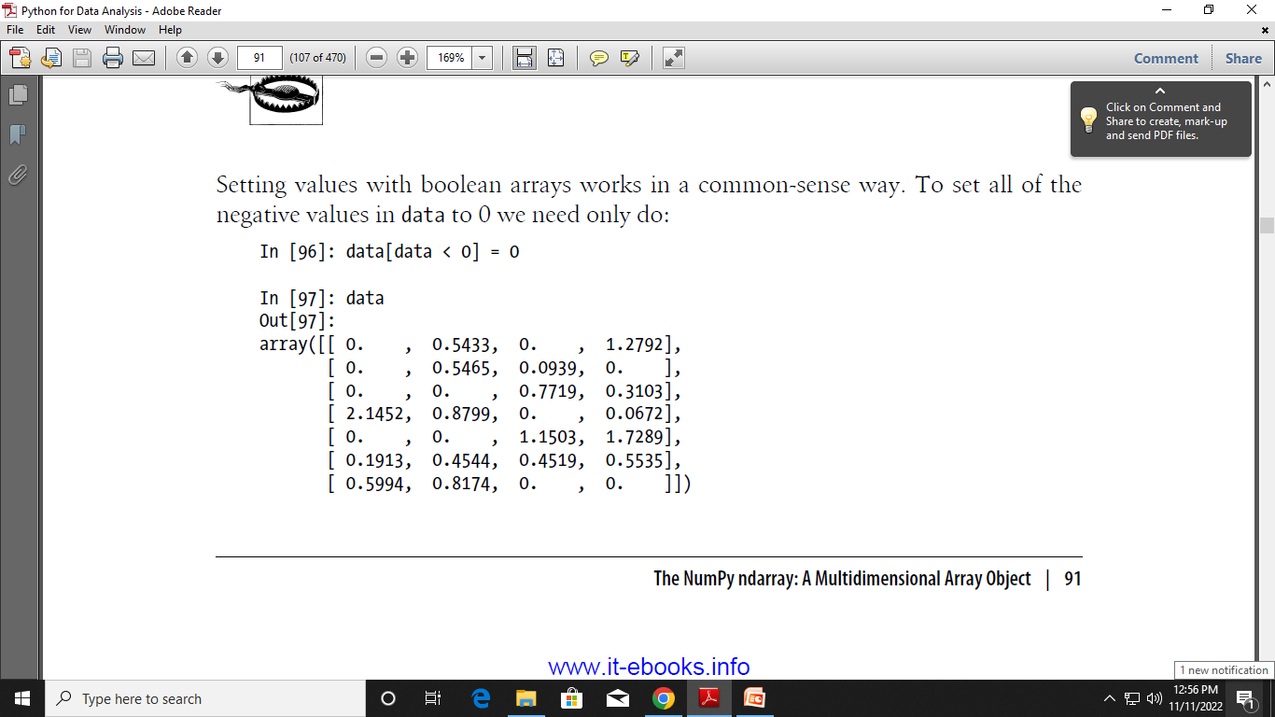

Slide 58
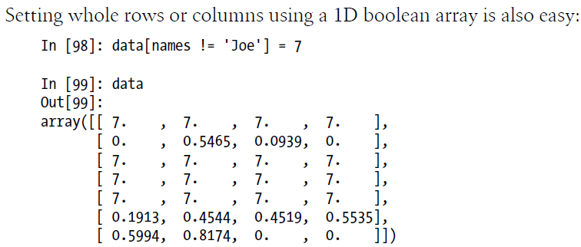

Slide 59
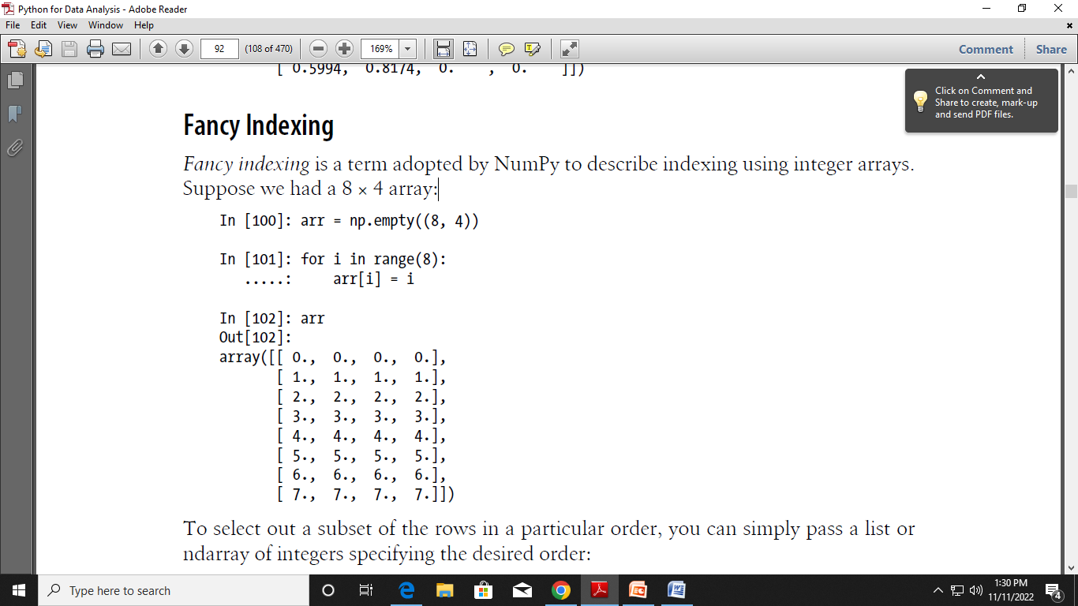
Fancy Indexing
Fancy indexing is a term adopted by NumPy to describe indexing using integer arrays.
Suppose we had a 8 × 4 array:

Slide 60
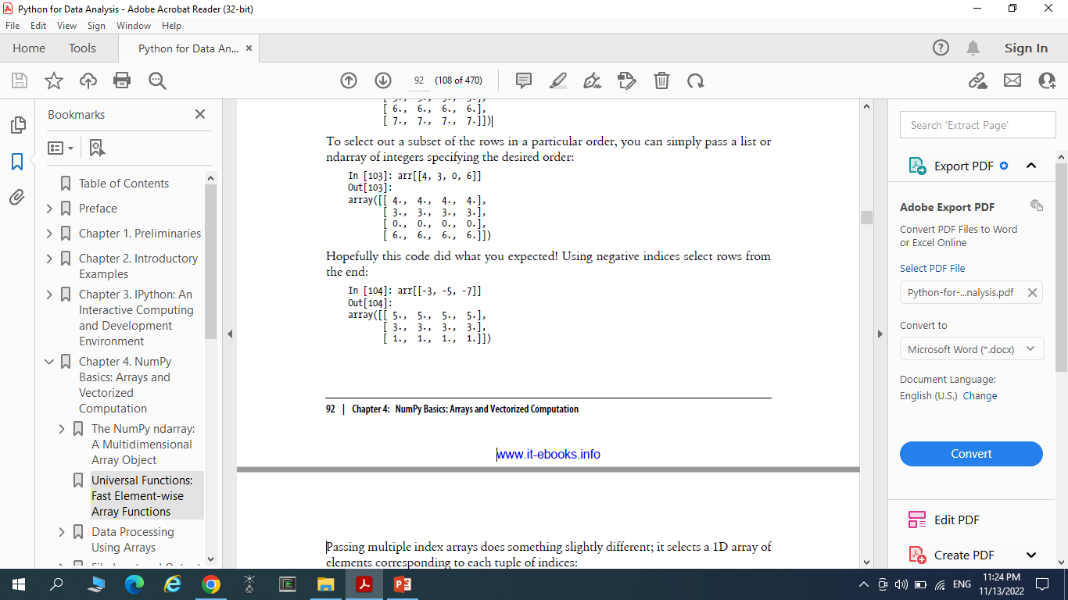
To select out a subset of the rows in a particular order, you can simply pass a list or ndarray of integers specifying the desired order:
Negative indices select rows from the end:

Slide 61
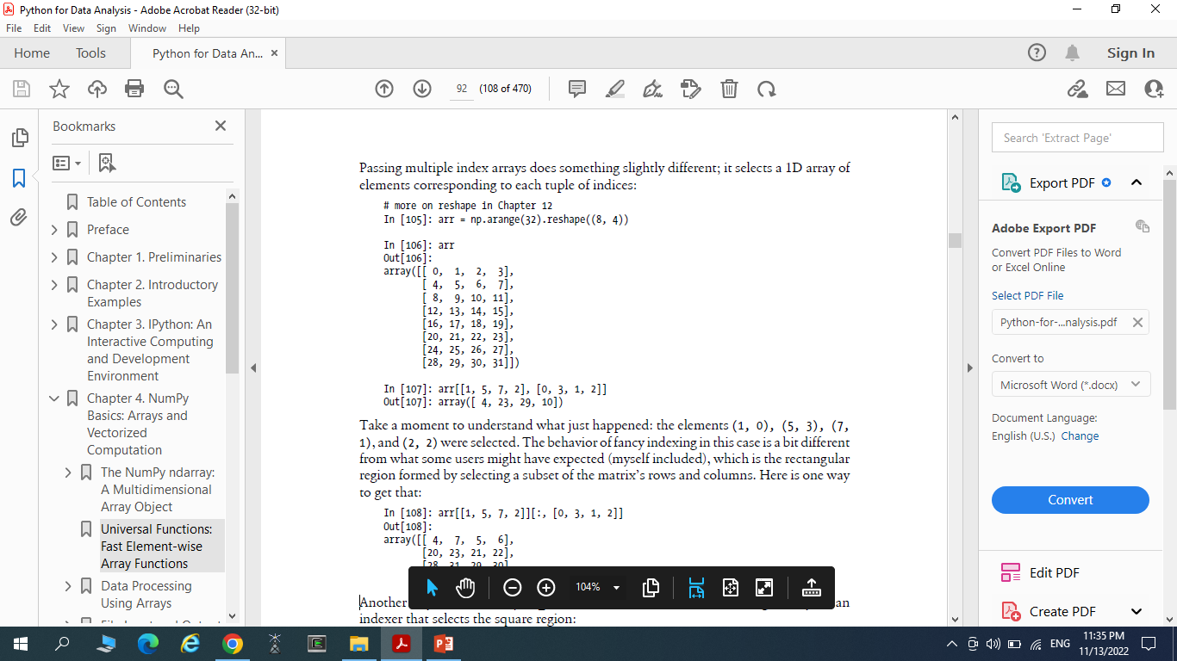
Passing multiple index arrays does something slightly different; it selects a 1D array of elements corresponding to each tuple of indices:
Fancy indexing, unlike slicing, always copies the data into a new array.

Slide 62
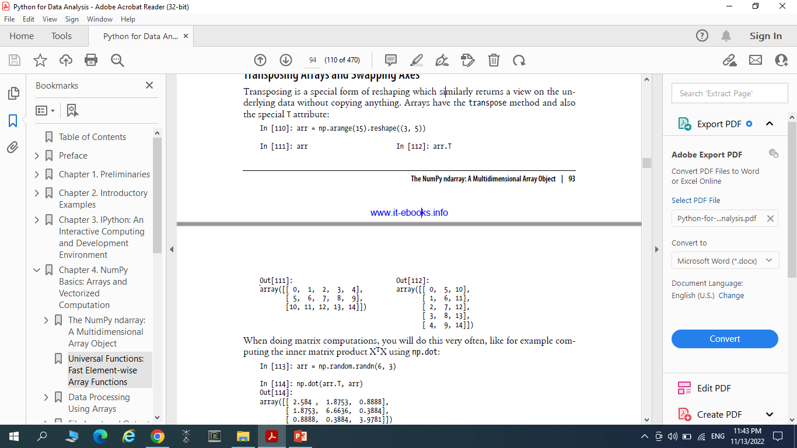
Transposing Arrays and Swapping Axes
Transposing is a special form of reshaping which similarly returns a view on the underlying data without copying anything.

Slide 63
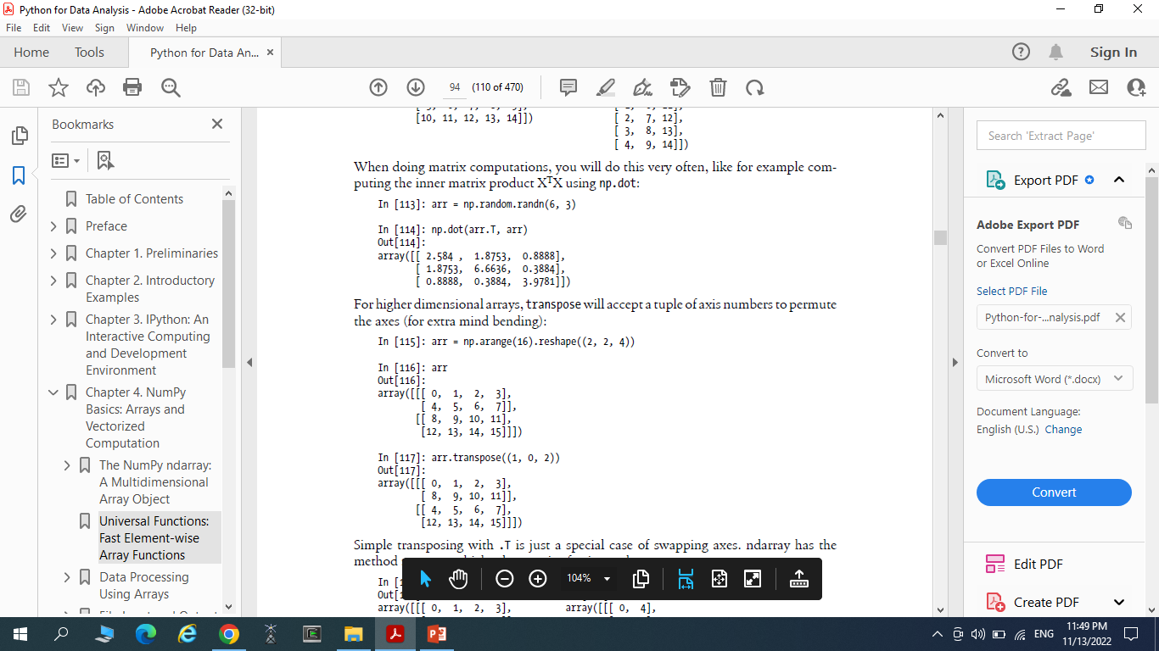
When doing matrix computations, we will do this very often, like for example computing the inner matrix product XTX using np.dot:
For higher dimensional arrays, transpose will accept a tuple of axis numbers to permute the axes

Slide 64
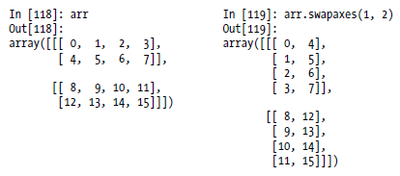
Simple transposing with .T is just a special case of swapping axes. ndarray has the method swapaxes which takes a pair of axis numbers:

Slide 65
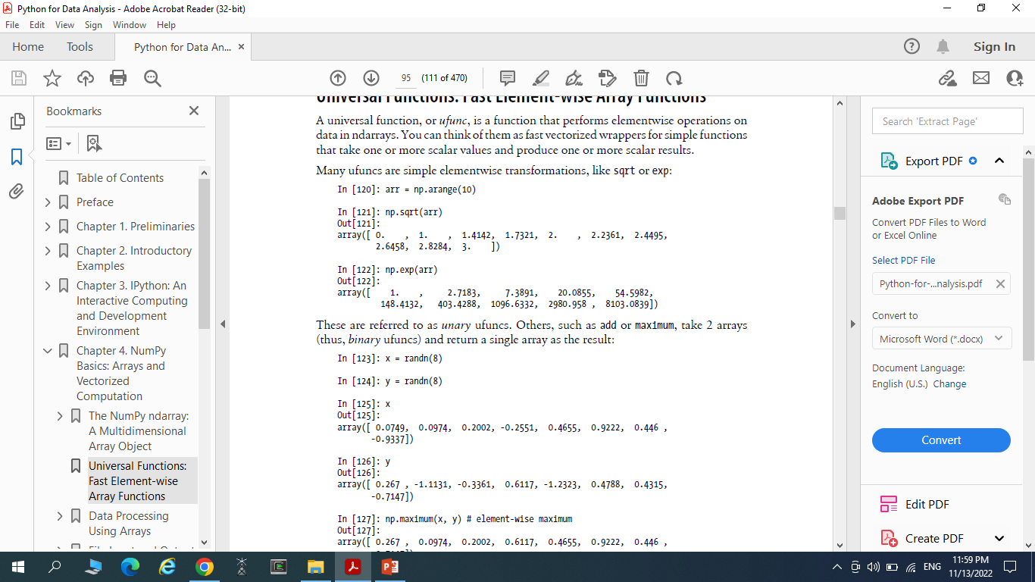
Universal Functions: Fast Element-wise Array Functions
A universal function, or ufunc, is a function that performs elementwise operations on data in ndarrays.

Slide 66
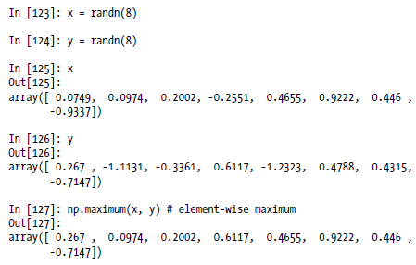
These are referred to as unary ufuncs. Others, such as add or maximum, take 2 arrays (thus, binary ufuncs) and return a single array as the result:

Slide 67
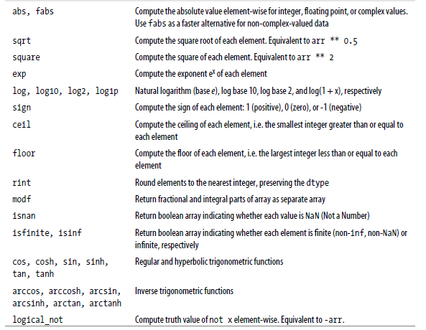
Unary ufuncs

Slide 68
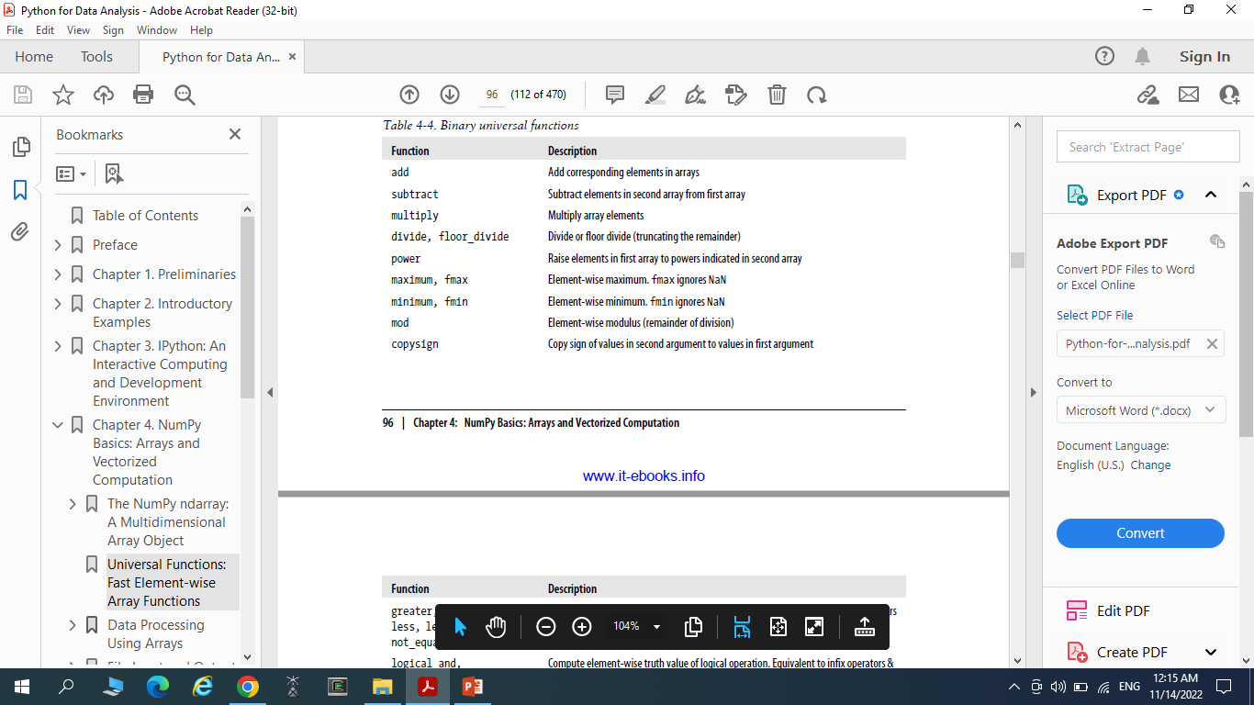
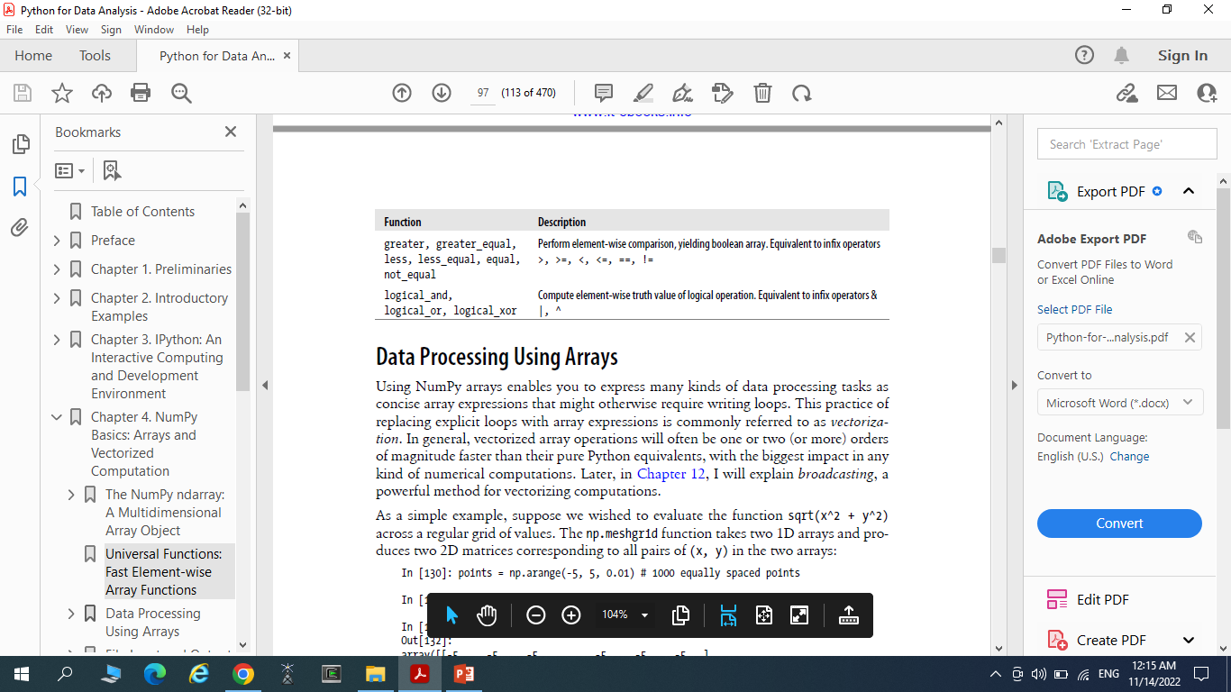
Binary universal functions

Slide 69
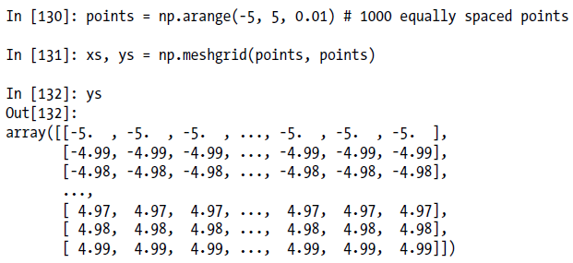
Data Processing Using Arrays
Suppose we wished to evaluate the function sqrt(x^2 + y^2) across a regular grid of values.
The np.meshgrid function takes two 1D arrays and produces two 2D matrices corresponding to all pairs of (x, y) in the two arrays:

Slide 70
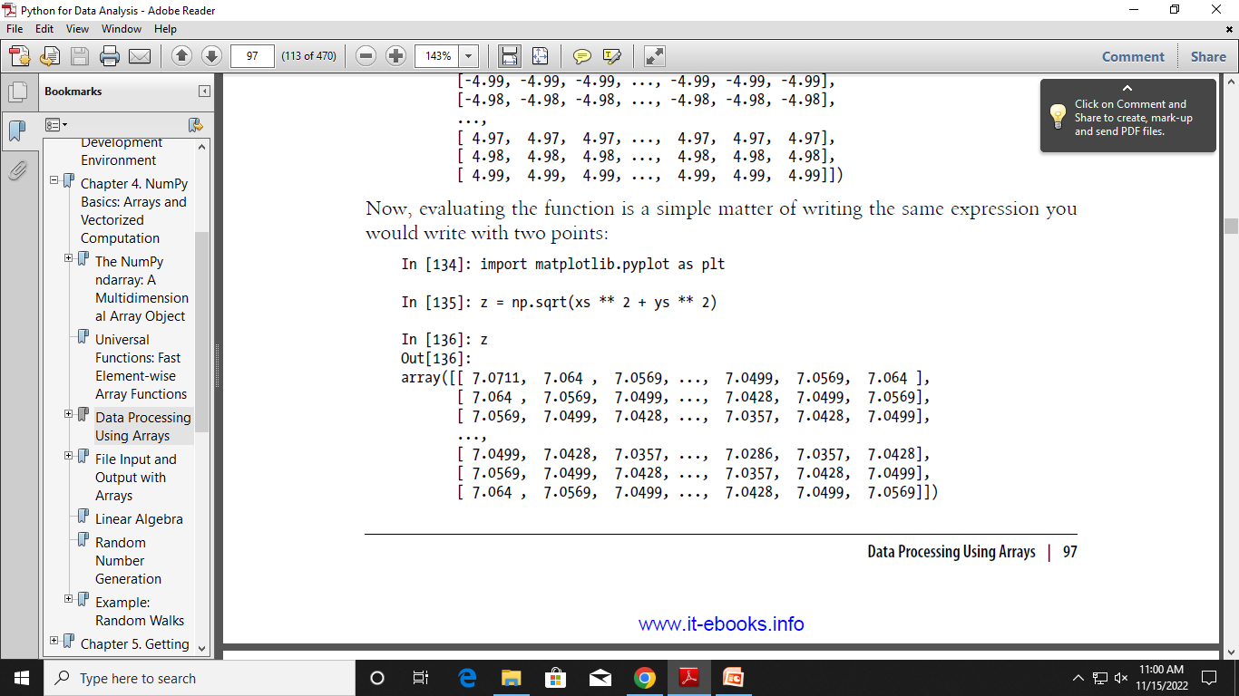
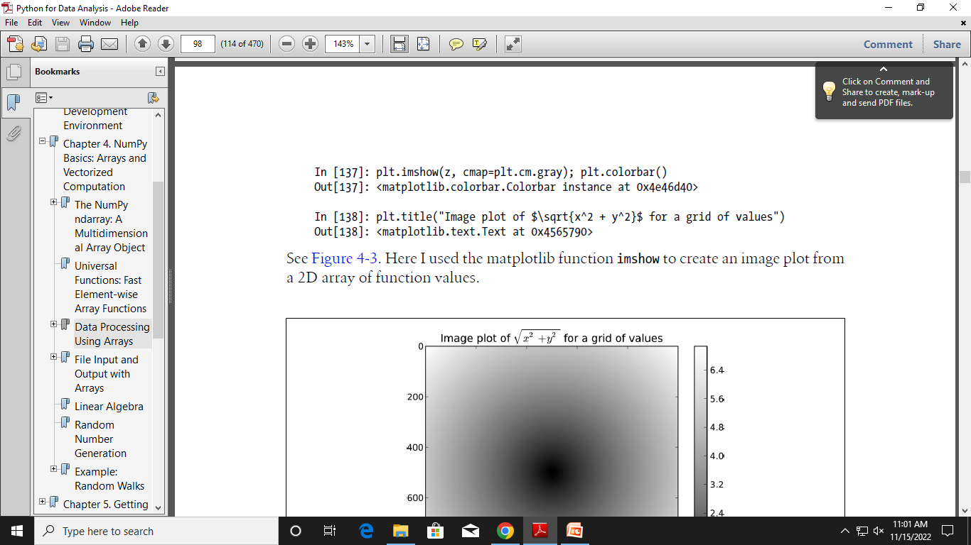

Slide 71
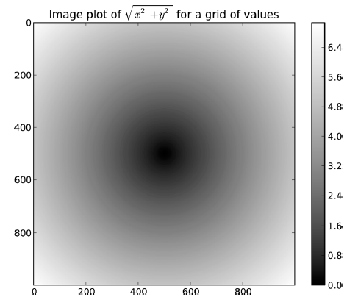

Slide 72
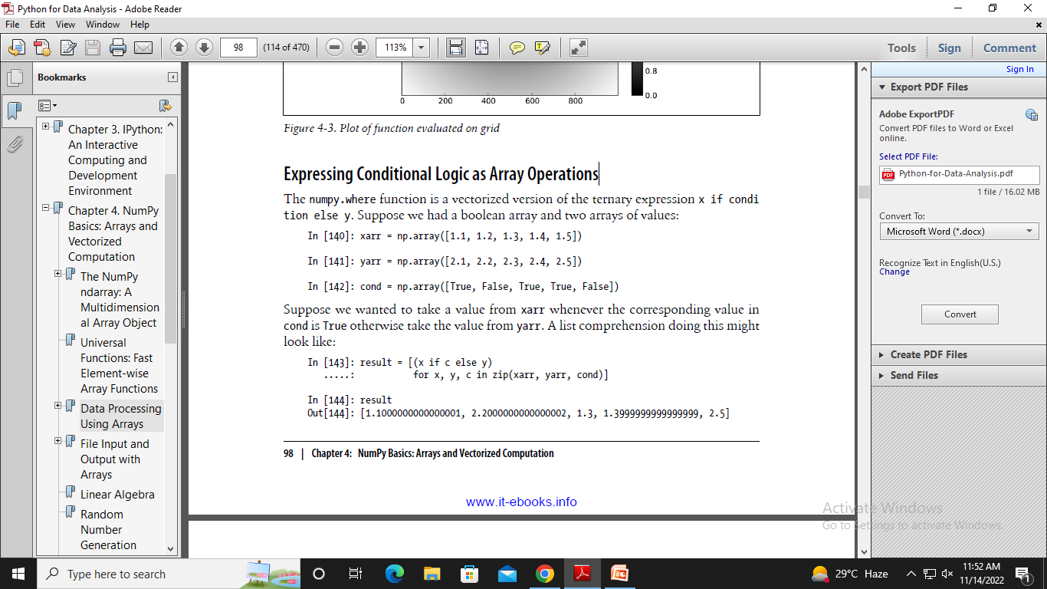
Expressing Conditional Logic as Array Operations
The numpy.where function is a vectorized version of the ternary expression x if condition else y.
Suppose we had a Boolean array and two arrays of values:
Suppose we wanted to take a value from xarr whenever the corresponding value in cond is True otherwise take the value from yarr. A list comprehension doing this might look like:
Drawbacks:
Not be very fast for large arrays
Not work with multidimensional arrays.
With np.where you can write this very concisely:

Slide 73
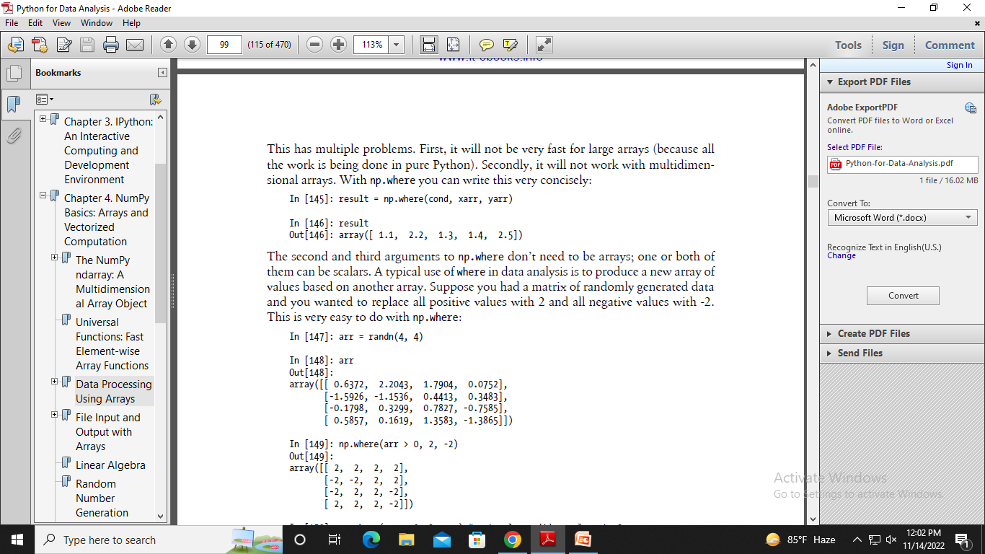
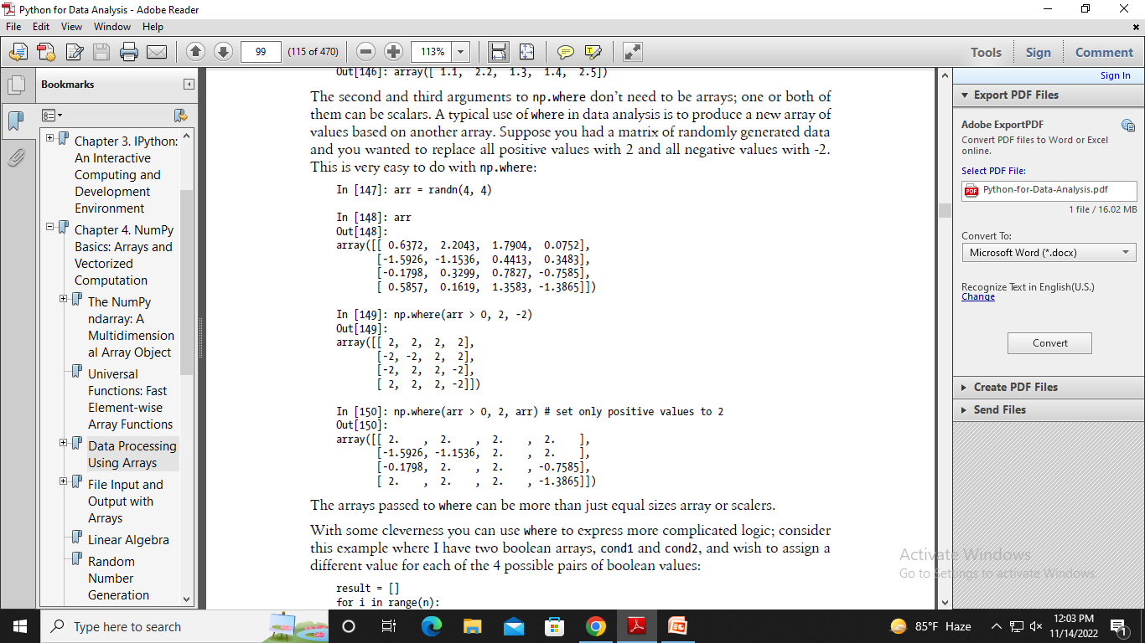

Slide 74


This for loop can be converted into a nested where expression:

Slide 75
Mathematical and Statistical Methods
A set of mathematical functions which compute statistics about an entire array or about the data along an axis are accessible as array methods.
Aggregations (often called reductions) like sum, mean, and standard deviation std can either be used by calling the array instance method or using the top level NumPy function.

Slide 76



Slide 77


cumsum and cumprod do not aggregate, instead producing an array of the intermediate results

Slide 78


Methods for Boolean Arrays
Sum is often used as a means of counting True values in a boolean array.
There are two additional methods, any and all, useful especially for boolean arrays.
any tests whether one or more values in an array is True, while all checks if every value is True

Slide 79


Sorting
NumPy arrays can be sorted in-place using the sort method

Slide 80

Multidimensional arrays can have each 1D section of values sorted in-place along an axis by passing the axis number to sort.

Slide 81


Unique and Other Set Logic
NumPy has some basic set operations for one-dimensional ndarrays. Probably the most commonly used one is np.unique, which returns the sorted unique values in an array:

Slide 82


np.in1d, tests membership of the values in one array in another, returning a boolean array

Slide 83


File Input and Output with Arrays
np.save and np.load are the two workhorse functions for efficiently saving and loading array data on disk.
The array on disk can then be loaded using np.load
We can save multiple arrays in a zip archive using np.savez and passing the arrays as keyword arguments:
In [186]: np.savez('array_archive.npz', a=arr, b=arr)
In [187]: arch = np.load('array_archive.npz')

Slide 84
Saving and Loading Text Files
Loading text from files is a fairly standard task.
The landscape of file reading and writing functions in Python can be a bit confusing for a newcomer, so we will focus mainly on the read_csv and read_table functions in pandas.
NumPy arrays using np.loadtxt or the more specialized np.genfromtxt.

Slide 85

Take a simple case of a comma-separated file (CSV) like:
np.savetxt performs the inverse operation: writing an array to a delimited text file.
genfromtxt is similar to loadtxt but is geared for structured arrays and missing data handling;

Slide 86

Linear Algebra
Linear algebra, like matrix multiplication, decompositions, determinants, and othe square matrix math, is an important part of any array library

Slide 87


numpy.linalg has a standard set of matrix decompositions and things like inverse and determinant.

Slide 88

Commonly-used numpy.linalg functions

